Slide 1

Tu préfères ?

Slide 2

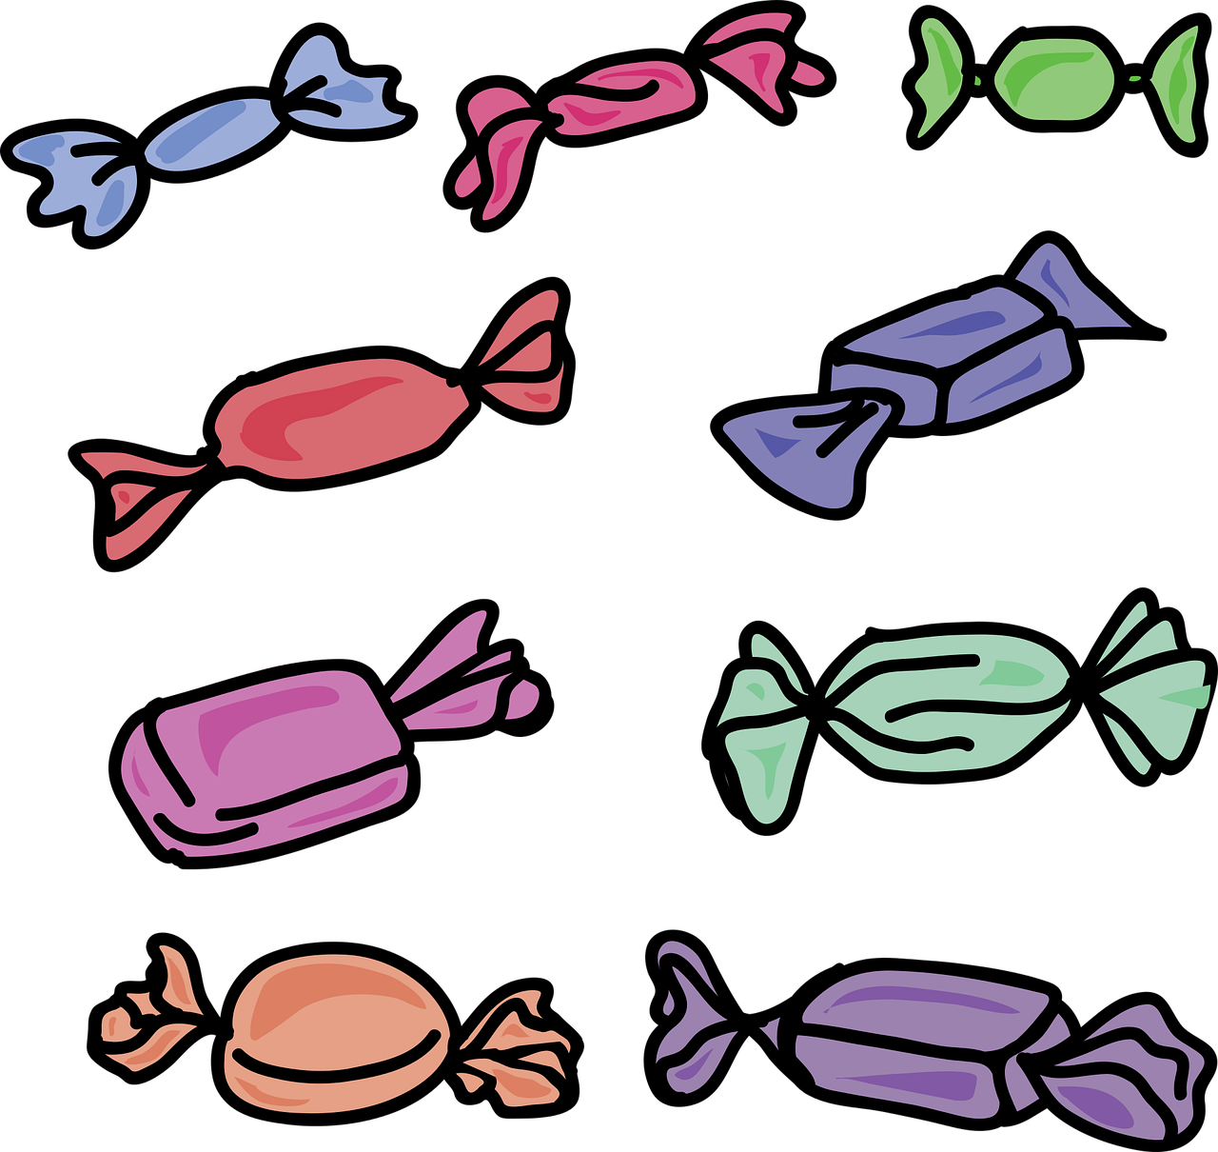
Tu préfères manger …
… du maïs soufflé quand tu regardes un film ?
Image by OpenClipart-Vectors on Pixabay, available under CC
… des bonbons quand tu regardes un film ?
Image by MahuaSarkar on Pixabay, available under CC

Slide 3
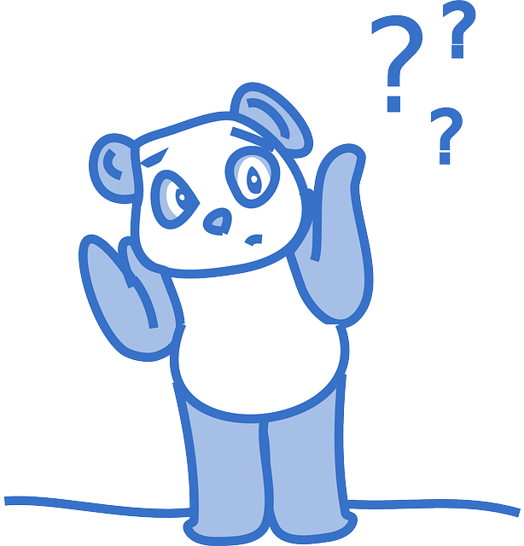
Pourquoi ?
Image by Clker-Free-Vector-Images on Pixabay, available under CC

Slide 4

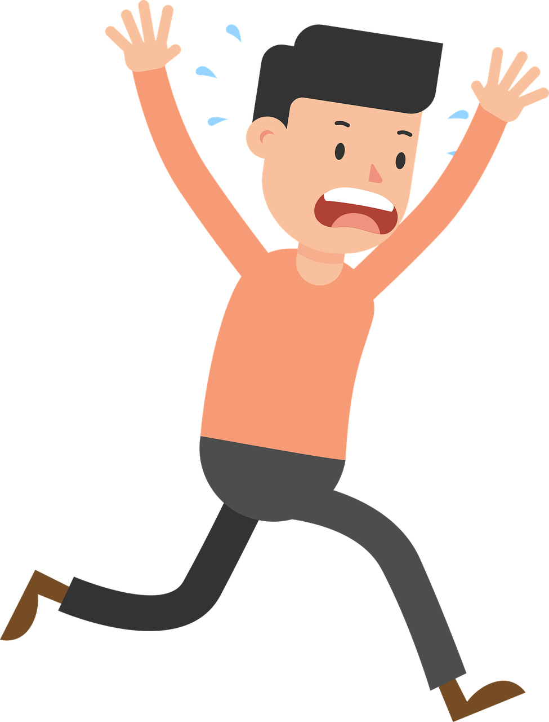
Tu préfères regarder des films …
… d’horreur ?
Image by Videoplasty on Pixabay, available under CC
… comiques ?
Image by raphaelsilva on Pixabay, available under CC

Slide 5
Pourquoi ?
Image by Clker-Free-Vector-Images on Pixabay, available under CC

Slide 6
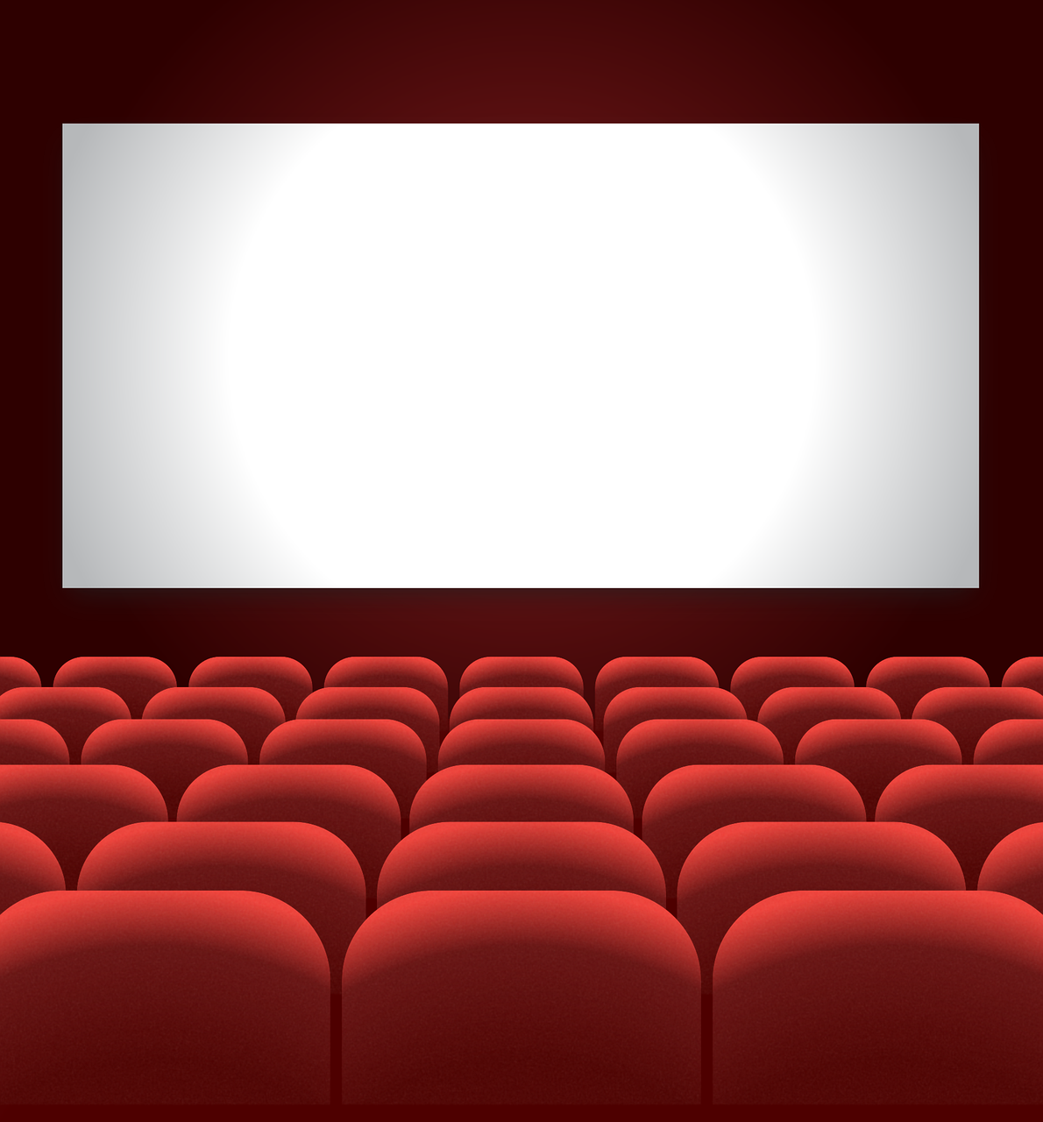

Est-ce que tu aimes …
… aller au cinéma ?
Image by hallucinogenizer on Pixabay, available under CC
… regarder netflix chez-toi ?
Imageby Chicheyani on Pixabay, available under CC

Slide 7
Pourquoi ?
Image by Clker-Free-Vector-Images on Pixabay, available under CC

Slide 8
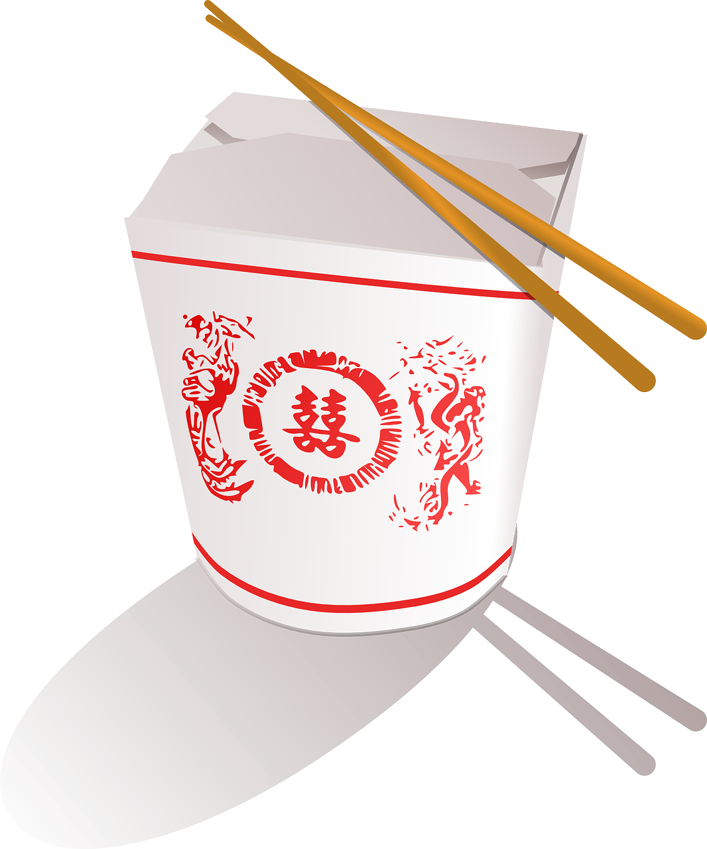
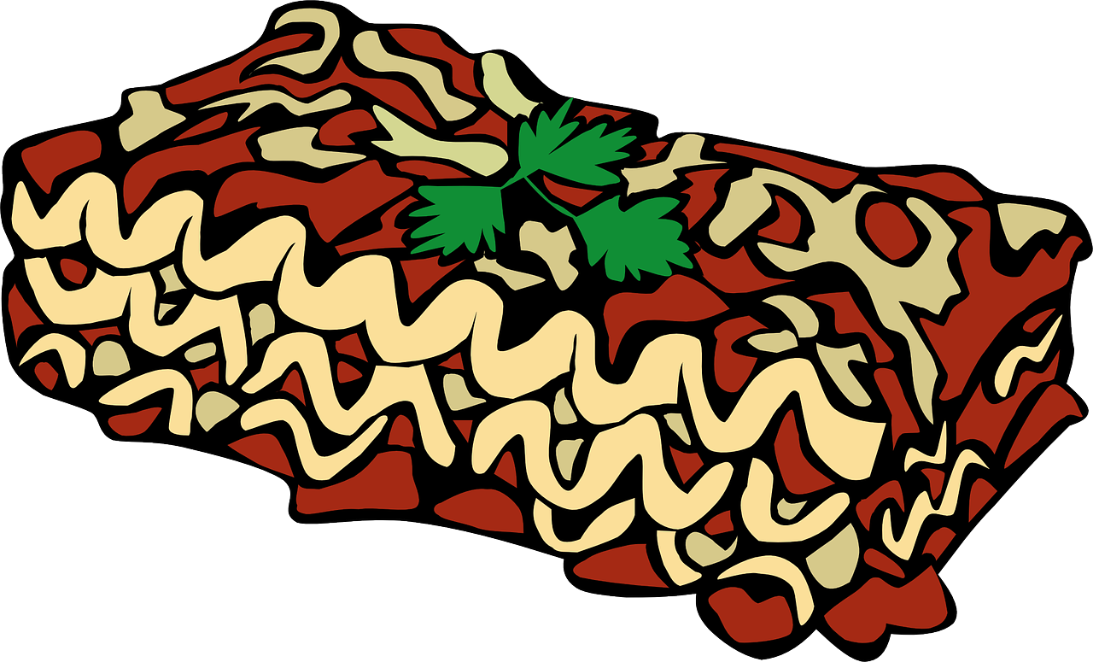
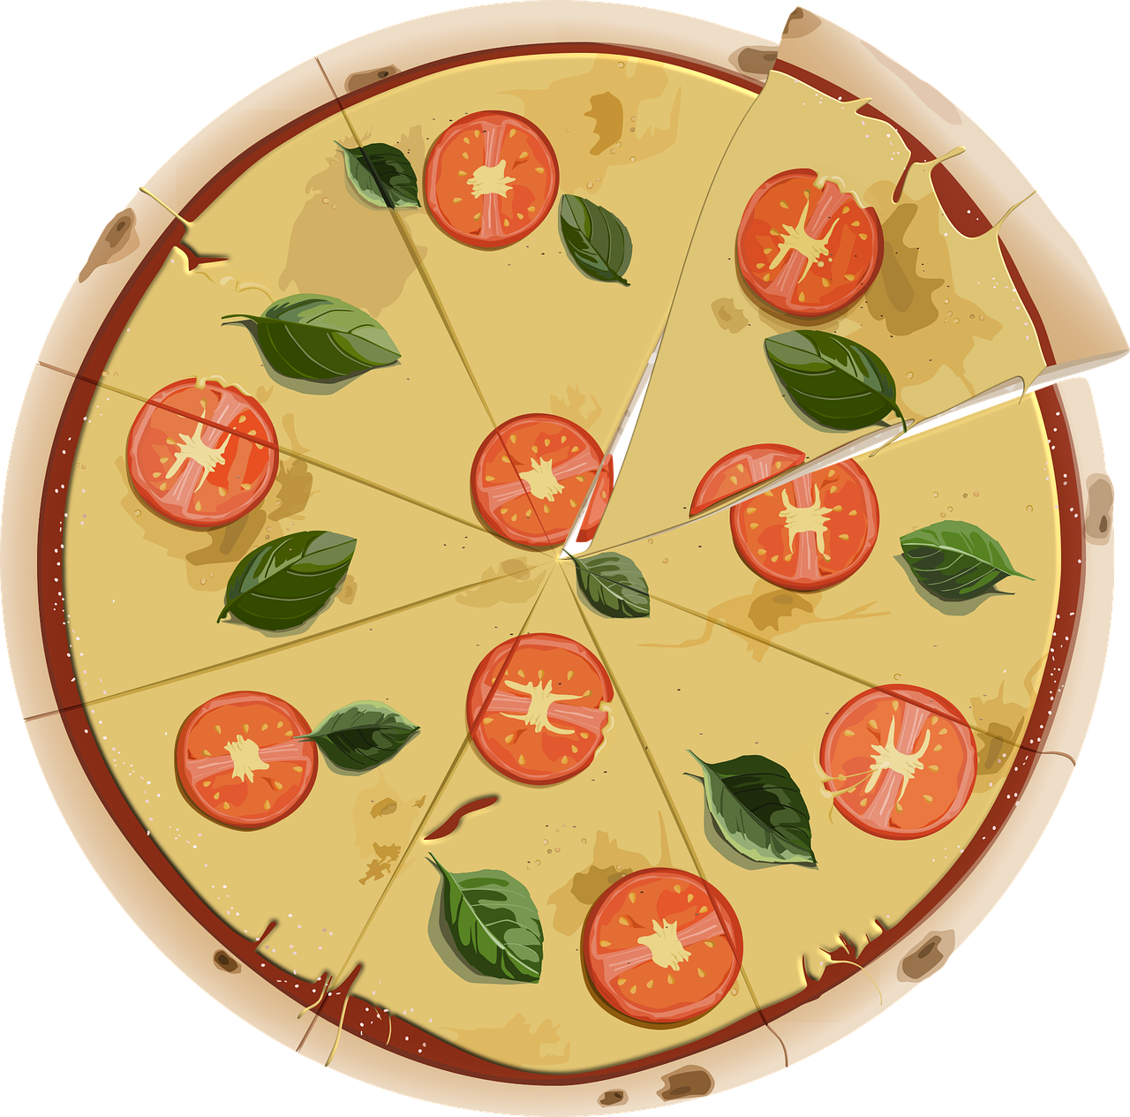
Est-ce que tu veux manger la cuisine …
… chinoise ?
Image by OpenClipart-Vectors on Pixabay, available under CC
… italienne ?
Image by Clker-Free-Vector-Images on Pixabay, available under CC
Image by DaModernDaVinci on Pixabay, available under CC

Slide 9
Pourquoi ?
Image by Clker-Free-Vector-Images on Pixabay, available under CC

Slide 10


Tu ne veux pas regarder …
… des films romantiques ?
Image by Clker-Free-Vector-Images on Pixabay, available under CC
… des documentaires ?
Image by Mohamed_hassan on Pixabay, available under CC

Slide 11
Pourquoi ?
Image by Clker-Free-Vector-Images on Pixabay, available under CC

Slide 12
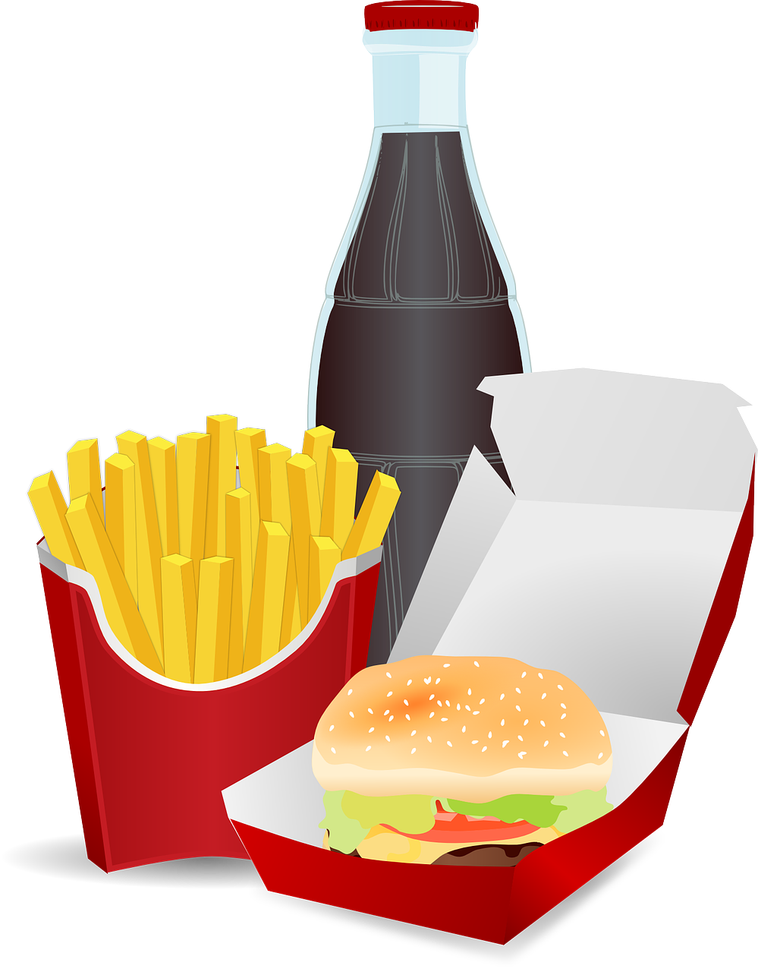

Ton ami.e choisit dîner à un restaurant …
… rapide ?
Image by OpenClipart-Vectors on Pixabay, available under CC
… chic ?
Image by OpenClipart-Vectors on Pixabay, available under CC

Slide 13
Pourquoi ?
Image by Clker-Free-Vector-Images on Pixabay, available under CC

Slide 14
Tu n’aimes pas t’assoir …
… près de l’écran ?
Image by hallucinogenizer on Pixabay, available under CC
… loin de l’écran ?
Image by hallucinogenizer on Pixabay, available under CC

Slide 15
Pourquoi ?
Image by Clker-Free-Vector-Images on Pixabay, available under CC

Slide 16
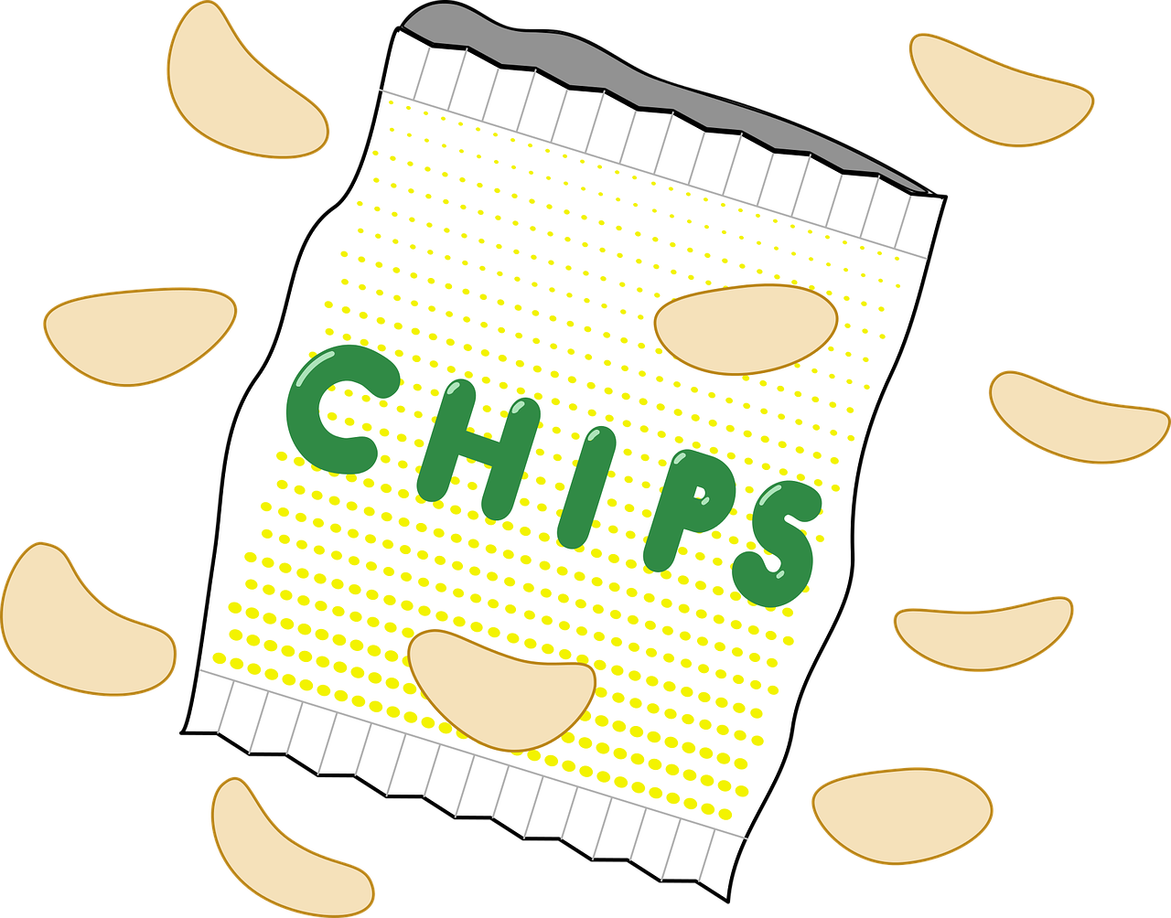
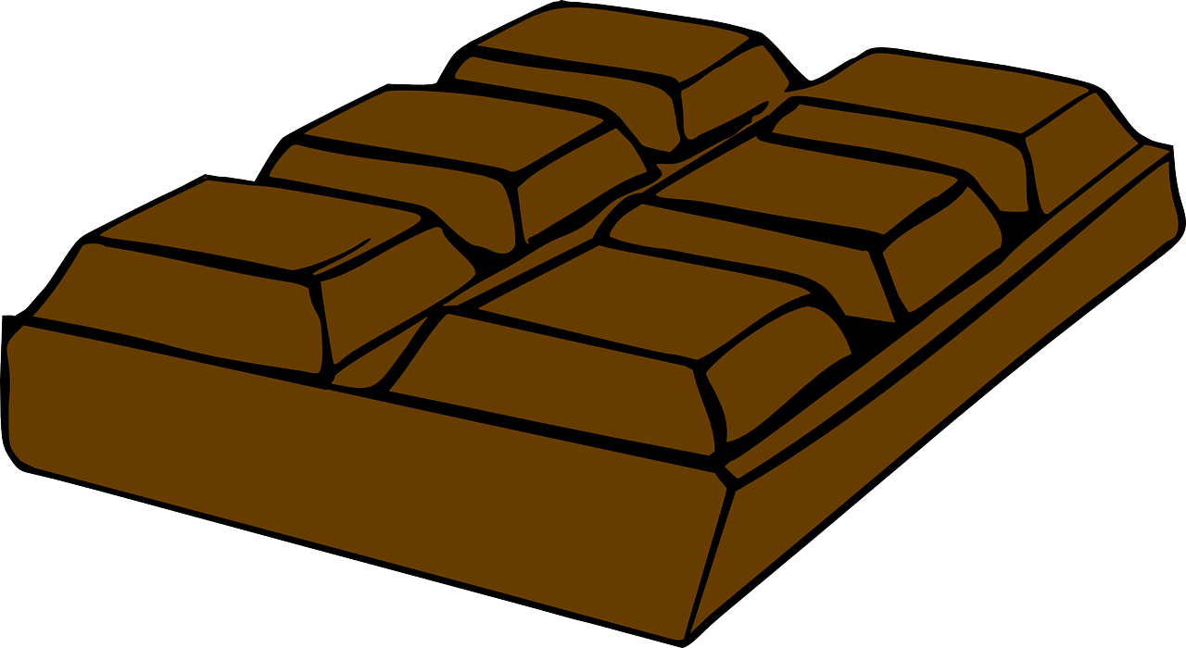
Est-ce que tu aimes manger …
… des croustilles ?
Image by OpenClipart-Vectors on Pixabay, available under CC
… des barres de chocolat ?
Image by OpenClipart-Vectors on Pixabay, available under CC

Slide 17
Pourquoi ?
Image by Clker-Free-Vector-Images on Pixabay, available under CC

Slide 18
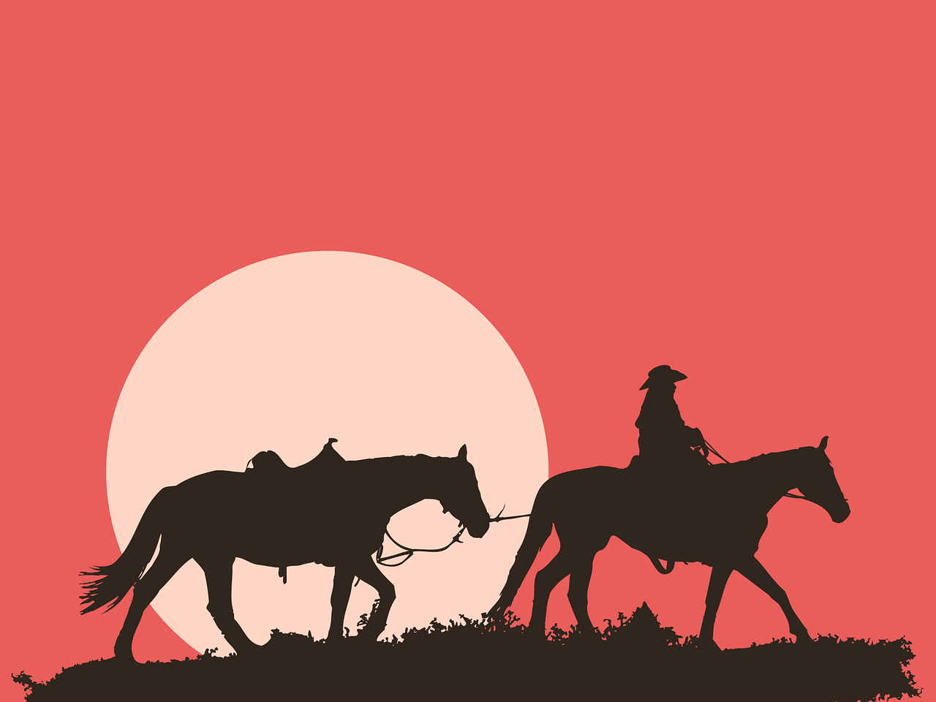
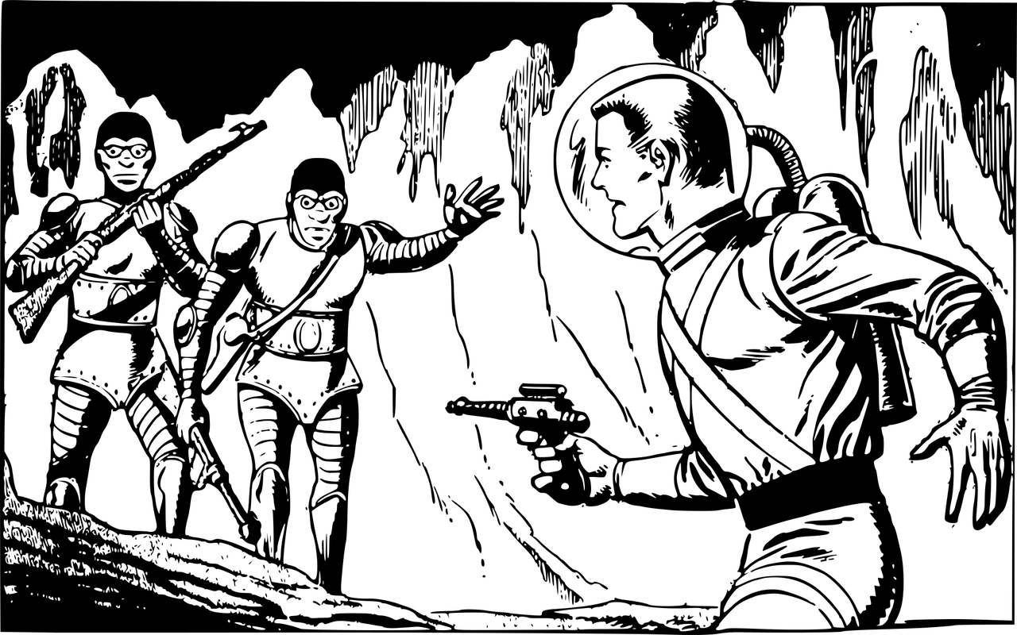
Tu préfères regarder …
… des westerns ?
Image by ha11ok on Pixabay, available under CC
… des films de science-fiction ?
Image by OpenClipart-Vectors on Pixabay, available under CC

Slide 19
Pourquoi ?
Image by Clker-Free-Vector-Images on Pixabay, available under CC

Slide 20


Tu n’aimes pas boire …
… des boissons gazeuses ?
Image by penClipart-Vectors on Pixabay, available under CC
… du jus ?
Image by Clker-Free-Vector-Images on Pixabay, available under CC

Slide 21
Pourquoi ?
Image by Clker-Free-Vector-Images on Pixabay, available under CC

Slide 22
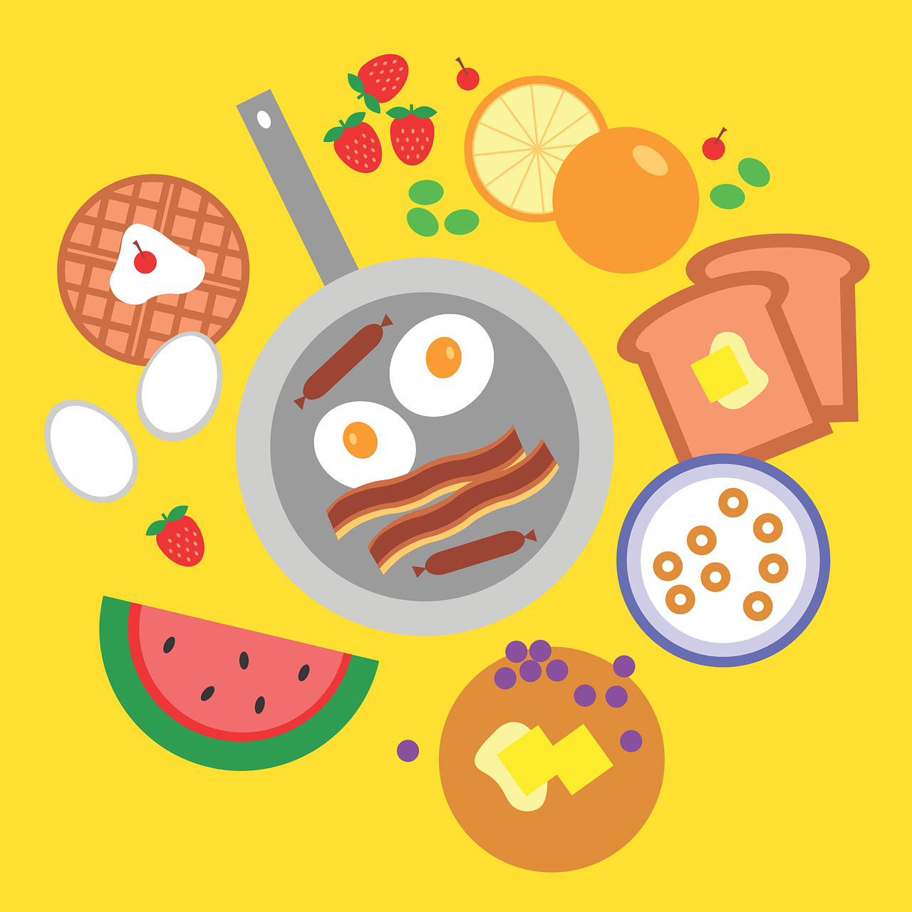

Tu ne veux pas …
… cuisiner chez-toi ?
Image by MarkOblivious on Pixabay, available under CC
… dîner dans un restaurant ?
Image by Clker-Free-Vector-Images on Pixabay, available under CC

Slide 23
Pourquoi ?
Image by Clker-Free-Vector-Images on Pixabay, available under CC

Slide 24
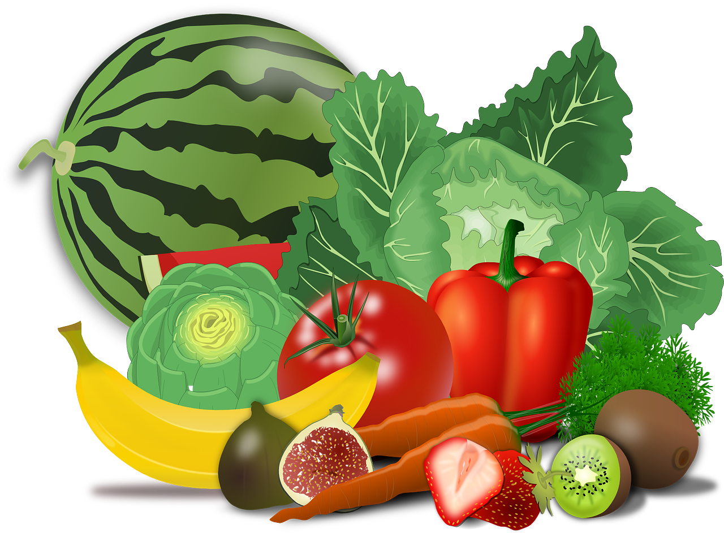
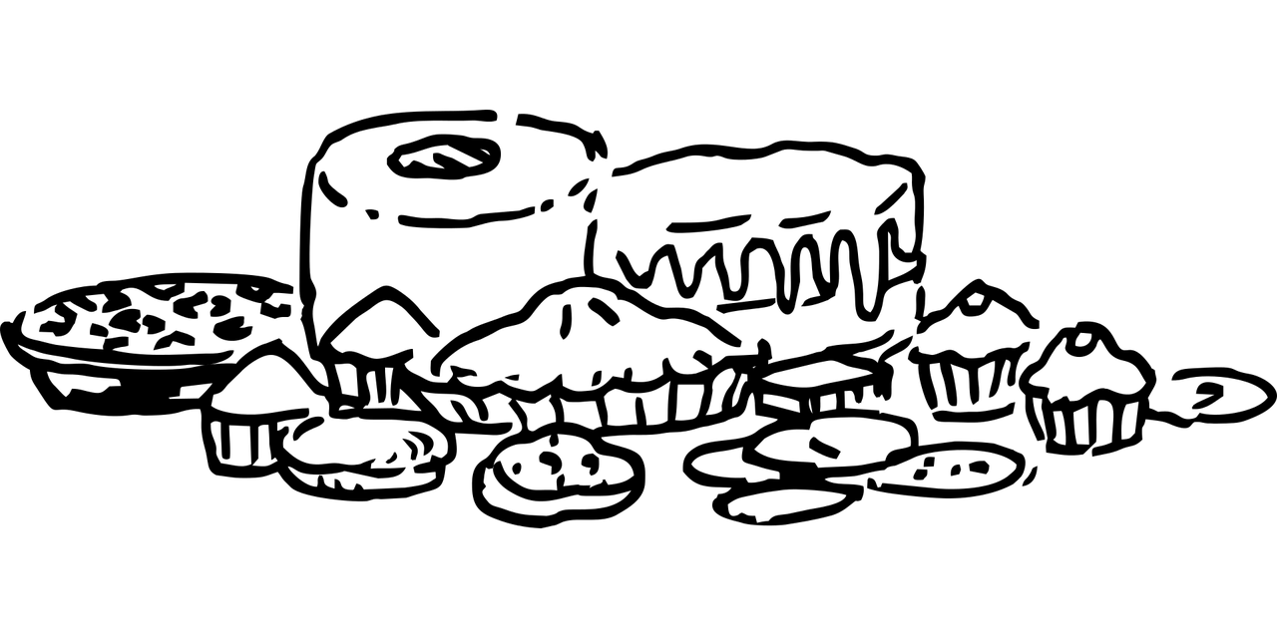
Ton ami.e choisit grignoter (manger comme collation) …
… des fruits et des légumes ?
Image by OpenClipart-Vectorson Pixabay, available under CC
… des pâtisseries ?
Image by b0red on Pixabay, available under CC

Slide 25
Pourquoi ?
Image by Clker-Free-Vector-Images on Pixabay, available under CC

