Slide 1
Coding
et les besoins des animaux
Maternelle/Jardin
Coding et les besoins des animaux by Jennifer Dumas CC BY-NC-SA All images from Canva

Slide 2
Connexions au programme de l'Ontario (Curriculum Connections)
This lesson integrates expectations from the updated 2026 Ontario Kindergarten Program across two primary areas:
Belonging and Contributing / Problem Solving and Innovating
  Overall Expectation 13 (The Natural World): Manifest an awareness of the basic needs and characteristics of living things.
  Conceptual Application: Students identify that animals (dogs, birds) have essential requirements to survive, specifically food (la nourriture) and water (l'eau).
Demonstrating Literacy and Mathematics Behaviour
  Overall Expectation 20 (Coding): Begin to explore foundational coding concepts by creating and following simple, sequential instructions.
  Conceptual Application: Students move directional arrows to create a sequential algorithm (a code) that moves a character from Point A to Point B.
  Overall Expectation 17 (Spatial Reasoning): Use spatial terms to describe relative locations, movement, and distance.
  Conceptual Application: Students use directional language (avance/move forward, monte/go up, descend/go down) to navigate a grid.
Coding et les besoins des animaux by Jennifer Dumas CC BY-NC-SA

Slide 3
Intentions d'apprentissage et Critères de succès
Learning Goals
We are learning to identify what living things need to survive and grow (food and water).
We are learning how to give clear, step-by-step instructions (a code) using directional arrows to move a character on a grid.
Success Criteria (In Child-Friendly "I Can" Statements)
I can name two things an animal needs to live (l'eau et la nourriture).
I can use arrows to show which way a character should go (droite, gauche, monte, descend).
I can put my arrows in the correct order (the right sequence) so my character reaches its goal.
Je peux nommer deux besoins des animaux pour vivre (l'eau et la nourriture).
Je peux utiliser des flèches pour montrer la direction d'un personnage (droite, gauche, monte, descend).
Je peux placer mes flèches dans le bon ordre (la bonne séquence) pour que mon personnage atteigne son but.
Coding et les besoins des animaux by Jennifer Dumas CC BY-NC-SA

Slide 4
Déroulement de la leçon (Le grand groupe)
Étape 1: Engagement & Vidéo)
Action : Gather students on the carpet. Show the video from Idello of the little girl taking care of her dog by giving it food and water.
Inquiry Questioning (Notice & Wonder) :
  « Qu'est-ce que vous remarquez dans la vidéo ? Que fait la petite fille ? » (Elle donne de l'eau et des croquettes).
  « Je me demande... qu'est-ce qui se passerait si la petite fille oubliait de donner de l'eau au chien ? »
Vocabulaire clé : Les besoins, la nourriture, l'eau, prendre soin de...
Etape 2: Modélisation et Exploration (Google Slides Grid)
The Problem : Display the Google Slide on the interactive board. Explain that now, a little bird is hungry and thirsty. It needs to reach its food (la nourriture) and water (l'eau) on the grid and avoid the obstacles.
Introducing the Code : Explain that the bird acts like a robot, it doesn't know where to go on its own. We must give it a code (an algorithm) by adding the digital arrows.
Spatial Discussion :
  Ask: « Pour aller vers l'eau, l'oiseau va gauche, droite, monter ou descendre ? »
  Have a student come up to drag and drop the first arrow.
  Ask the class: « Si l'oiseau suit cette flèche, où arrive-t-il ? »
  Continue this until the path to the food and water is complete.
Étape 3 : Vérification et Communication (Debugging)
Complete the sequence of arrows together as a class.
To test the code, pretend to press "Play." You can drag the bird along the arrows. The whole class makes robot sounds (Bip boop!) and reads the code aloud together in French: « droite, gauche, monte, descend ! »
Celebrate when the bird successfully reaches its food/water.
Coding et les besoins des animaux by Jennifer Dumas CC BY-NC-SA

Slide 5
Application individuelle (Paper-and-Pencil Coding)
Before transitioning to open-ended play, students complete a quick individual paper activity to demonstrate their understanding. This paper serves as excellent physical media for individual pedagogical documentation.
The Task: Give each student a printed worksheet featuring a simple 3x3 or 4x4 grid. On the grid, there is a bird at the start, and boxe containing a worm (ver de terre) and water (l'eau).
Action: Students write or draw the sequential arrows up (en haut), down (en bas) down, right (droite), left (gauche) into the boxes on the page to program the bird's path to its needs.
Differentiation:
  Support: Have pre-cut arrow stamps or small arrow stickers they can paste into the code boxes instead of drawing them.
  Extension: Ask students to orally "read" their written code to an educator using their French spatial words
Coding et les besoins des animaux by Jennifer Dumas CC BY-NC-SA

Slide 6
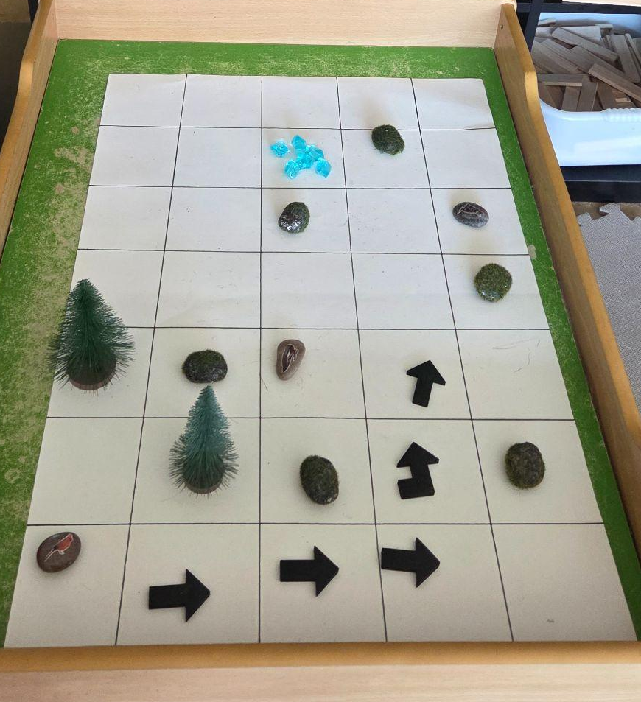
Prolongement : Opportunité d’apprentissage (learning opportunity)
Transition the concept into a tangible learning center. This can be set up inside on a tabletop/floor mat or outside on the pavement/grass.
Matériel (Loose Parts)
La grille : A grid playmat, painter's tape on a table (inside), or a chalk-drawn grid on the asphalt (outside).
Les figurines : Small plastic animals (dogs, birds) plush toys, rocks with animal stickers, etc.
Loose Parts for Coding : Popsicle sticks to form arrows, flat stones with painted arrows, or laminated arrow cards.
Loose Parts for Animal Needs : Blue glass beads (l'eau), acorns/wooden rings/real seeds (la nourriture), small sticks or blocks (l'abri).
Co-constructing the Center with Students
“Les amis, aujourd'hui à notre centre d'exploration, la grille du Google Slide est devenue réelle. Vous pouvez aider nos petits animaux à trouver leur nourriture et leur eau. Mais attention, ils ne parlent que la langue des robots ! Vous devez utiliser nos flèches pour programmer leur chemin.”
Coding et les besoins des animaux by Jennifer Dumas CC BY-NC-SA

Slide 7
Documentation pédagogique (What to Look For)
Use open-ended inquiry prompts while observing students at the paper station or the loose parts center to document their thinking:
To prompt planning: « Je remarque que ton chien a très soif. Qu'est-ce que tu vas mettre comme première flèche pour l'aider ? Et ensuite ? »
To prompt debugging: « Oh regarde, ton oiseau-robot a glissé à côté de ses graines. Je me demande s'il y a une flèche qui s'est trompée de direction... Regardons ton code ensemble ! »
What the Child Does (Evidence) | What it Demonstrates (Learning Domain)
Places or draws one arrow, moves the animal/finger, then draws the next arrow (step-by-step). | Math/Coding: Exploring coding through trial-and-error. Beginning to understand spatial cause-and-effect.
Fills out the entire row of arrows on their paper before tracking it with their finger. | Math/Coding: Advanced computational thinking. Demonstrating the ability to plan an entire sequential algorithm ahead of time.
Verbally uses words like avance, monte, descend while completing their paper or moving loose parts. | Language/Spatial Reasoning: Incorporating French spatial terminology accurately in context.
Places a block on the loose parts grid and says, "The dog can't go here, it's a big wall, he has to go around." | Problem Solving: Adding constraints and self-correcting paths to solve complex spatial problems.
Correctly targets the blocks containing both the blue beads and the seeds. | Natural World (Science): Expressing a clear understanding that the living animal requires both food and water to survive.
Coding et les besoins des animaux by Jennifer Dumas CC BY-NC-SA

Slide 8
Extension
Once students understand the basic mechanics of coding, you can print the blank grid templates along with the themed sheets (animals, foods) or create your own based on their interest, to let children design their own custom coding boards. Students simply choose a theme, place their character, scatter targets or obstacles (like a treasure chest or different foods (healthy/sometimes foods) onto the grid, and then draw or paste the arrows to program a safe path. This seamlessly connects computational thinking to their personal interests, transforming them from users of code into creative problem solvers who can challenge their peers to decode their custom game.
Coding et les besoins des animaux by Jennifer Dumas CC BY-NC-SA

Slide 9
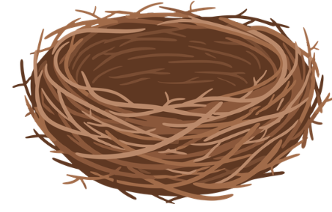

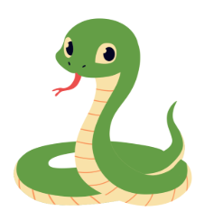
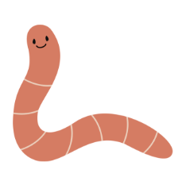
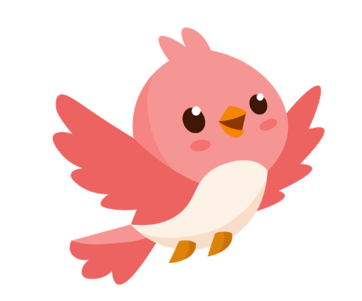
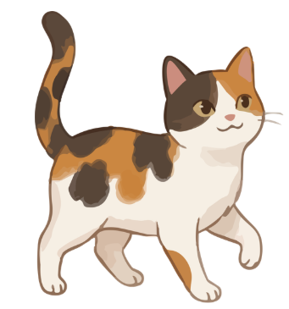

Slide 10
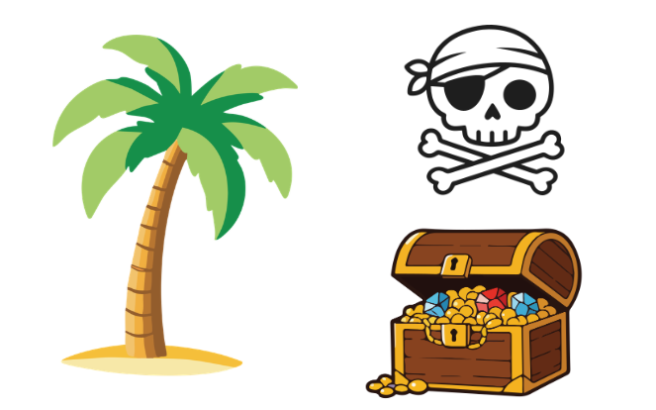
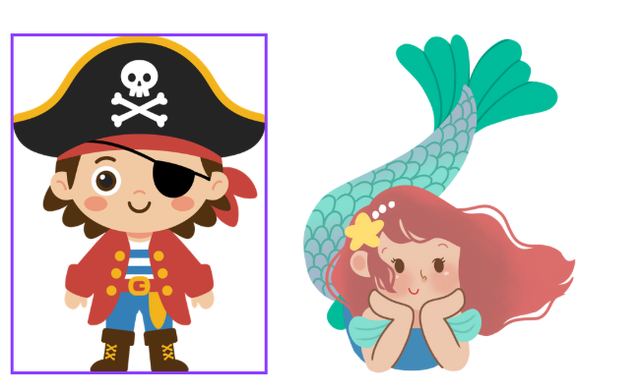
Depart

Slide 13
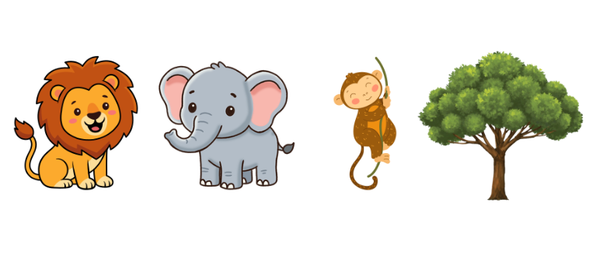
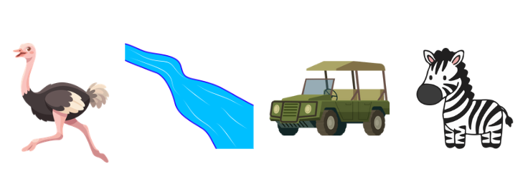

Slide 14
